Slide 1

Baseball Databank Analysis Report
A detailed exploration and analysis of baseball data.

Slide 2
Applied Statistics for Data Science
Applied Statistics for Data Science Nawaf Abdulrhman Alageel- 44410754 Mohammed Khalid Altufayhi - 444003827 Abdullah Mansour Habit - 444003327 Muhammad Saad Al-Sarhani- 444006145

Slide 3

INTRODUCTION
The Baseball Databank, sourced from Sean Lahman's website, is a rich archive of historical baseball data, tracing the game's history, strategy, and evolution. While the initial release might miss some tables, it remains substantial, with updates planned.
The databank's structure is player-centric, with each player having a unique playerID, linking to all their data. The primary table, MASTER, holds player biographical details.

Slide 4
R Code Overview
1. Data Acquisition from CSV files.
2. Data Preprocessing & Normalization.
3. Descriptive Statistics.
4. Further Data Analysis such as top earners, performance vs. salary, etc.

Slide 5
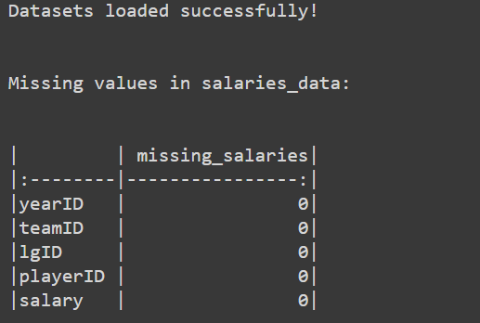
1. Dataset Collection
Datasets AllstarFull.csv and Salaries (1).csv were successfully loaded. Initial checks for missing values in the salaries dataset revealed:

Slide 6

2. Data Processing and Normalization
The data was cleaned by addressing missing values and outliers. For instance, missing gameID entries were removed, and missing values in the GP column were replaced with the median. Outliers in the GP column were identified and managed using the Interquartile Range (IQR) method.

Slide 7
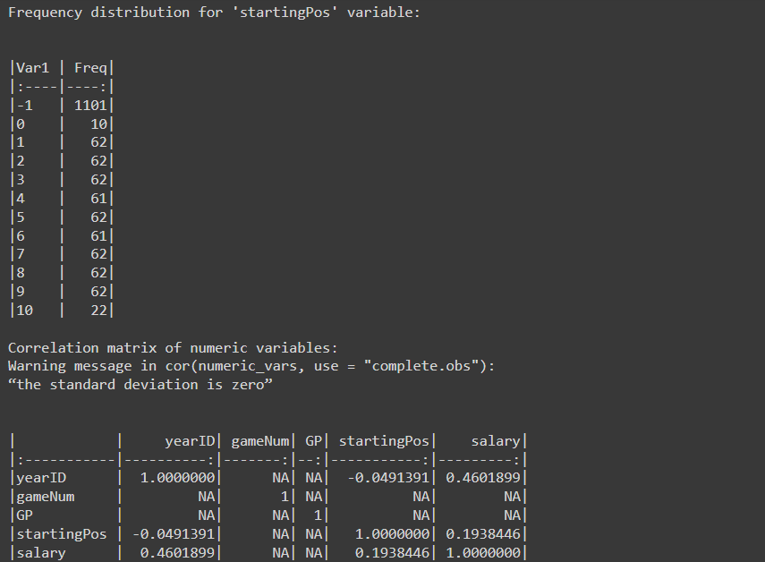
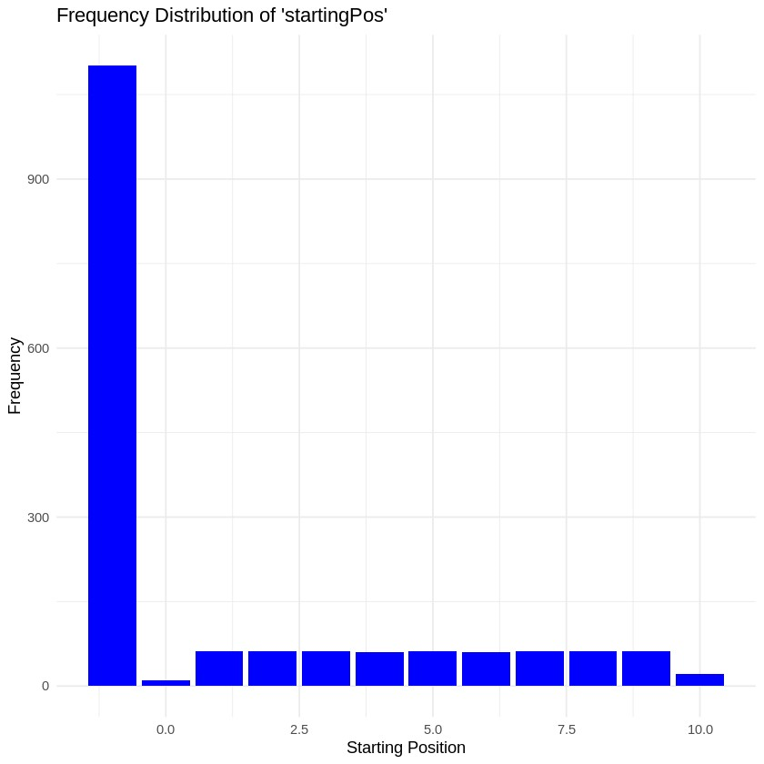
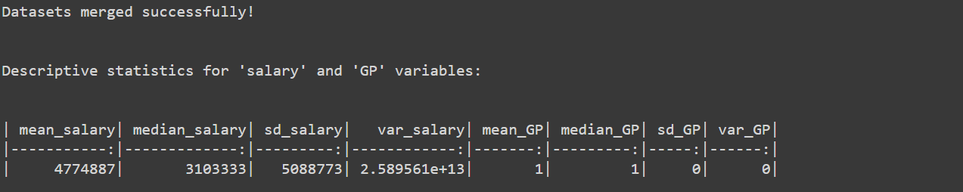
3. Descriptive Statistics
The mean and median salary represent the average and middle value of salaries, respectively. Standard deviation and variance provide insights into the salary data spread. Similar measures for Games Played (GP) give insights into player performances.

Slide 8

4. Merging Data
The All-Star and Salaries datasets were merged using the playerID and yearID columns, providing a unified dataset for analysis.

Slide 9
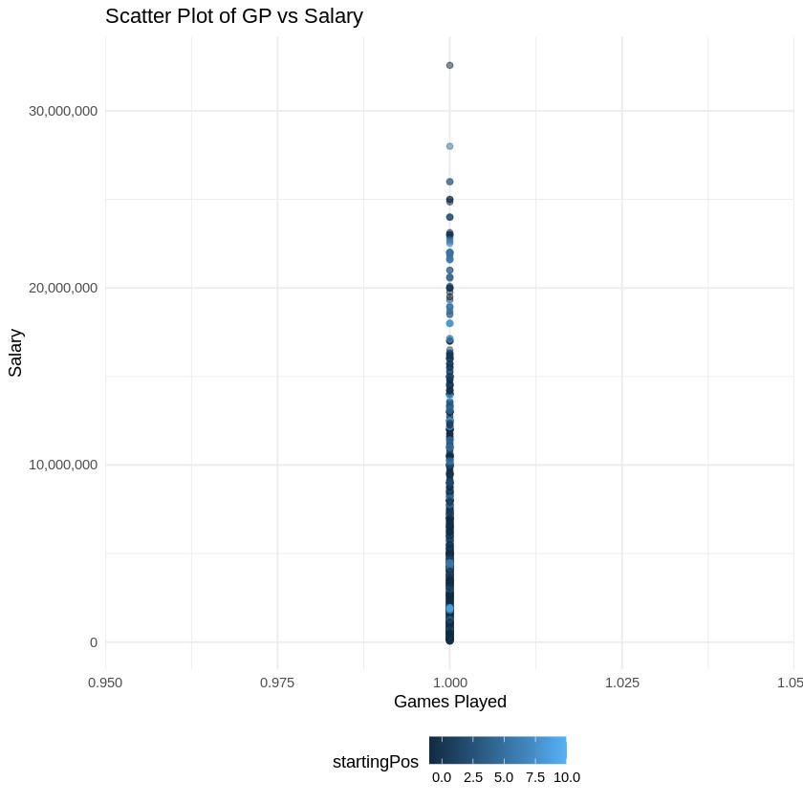
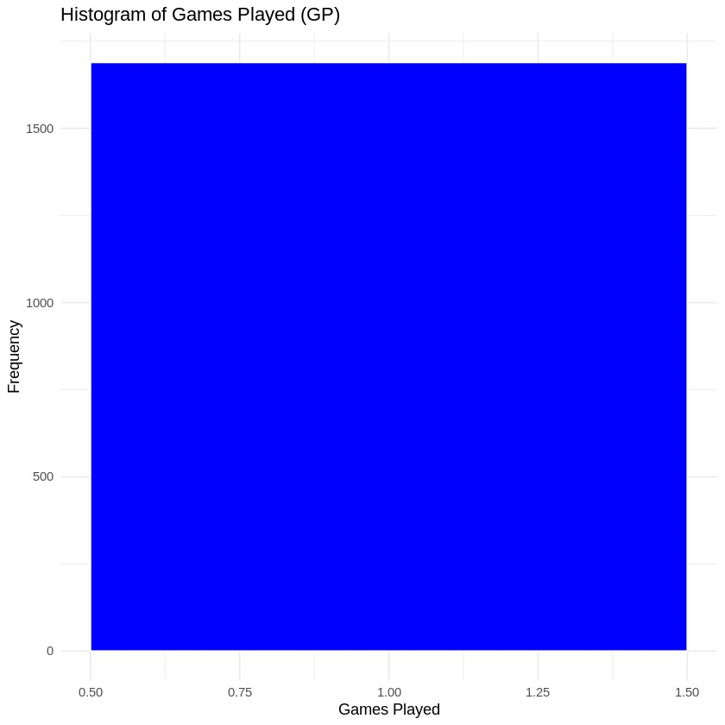
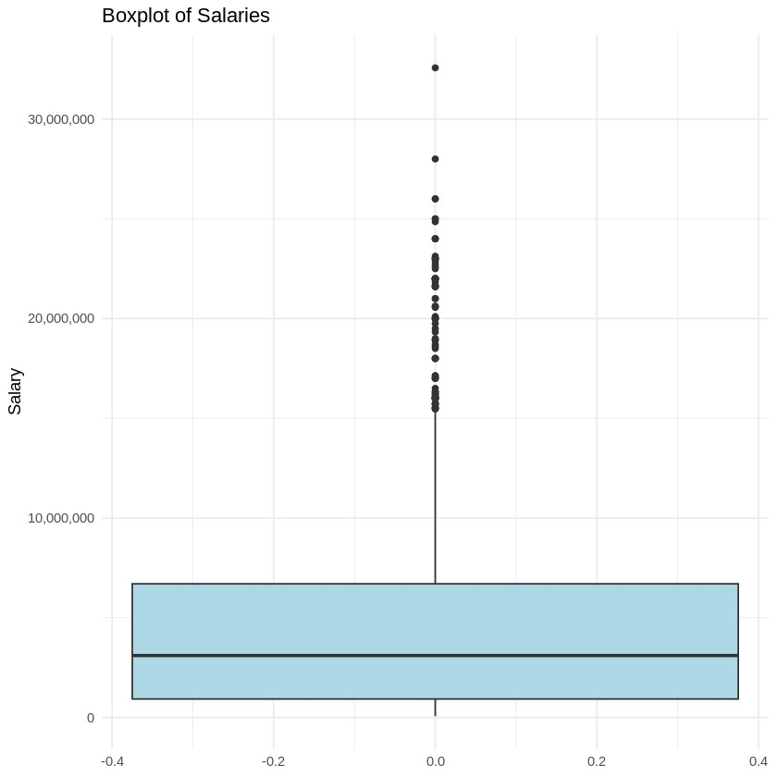
5. Data Exploration and Visualization
Preliminary data exploration provided key insights. Histograms, boxplots, and scatter plots were used for visualizations, emphasizing salary distributions and the relationship between games played and salary.

Slide 10
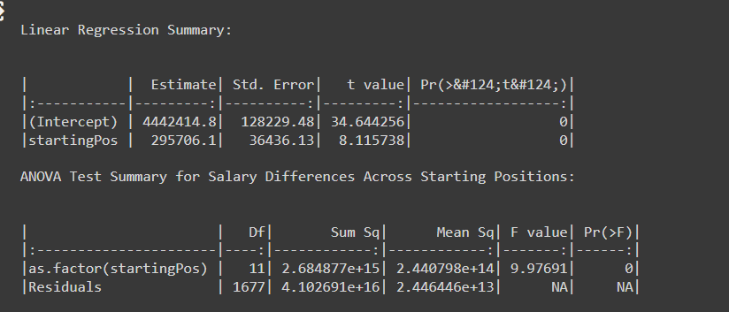
6. Advanced Analysis
Linear regression was used to gauge the influence of games played and starting position on salaries. ANOVA tested for salary differences across positions.

Slide 11
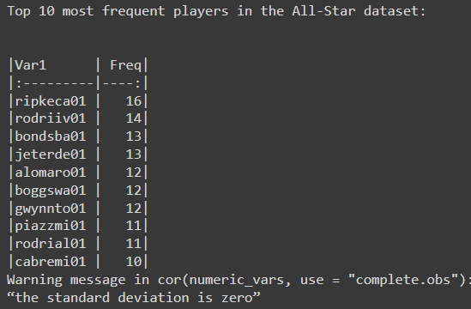
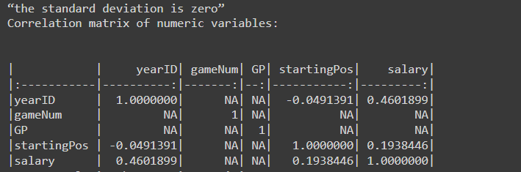
7. Extended Data Analysis
Analysis included player frequency, salary distribution over years, correlations, and average salaries by starting position.

Slide 12
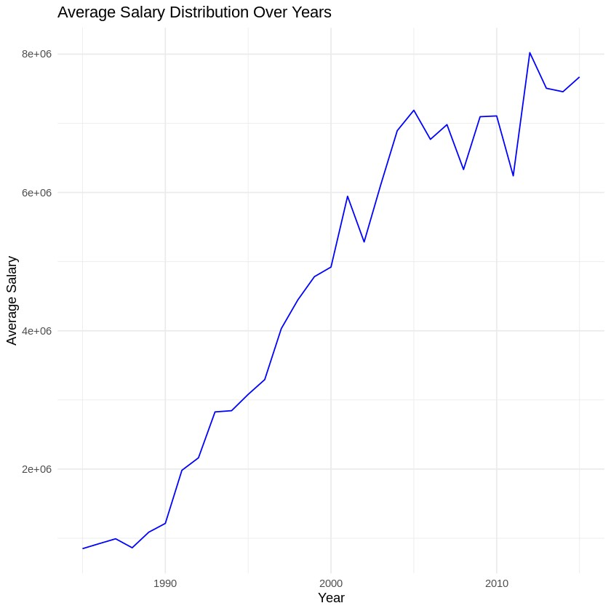
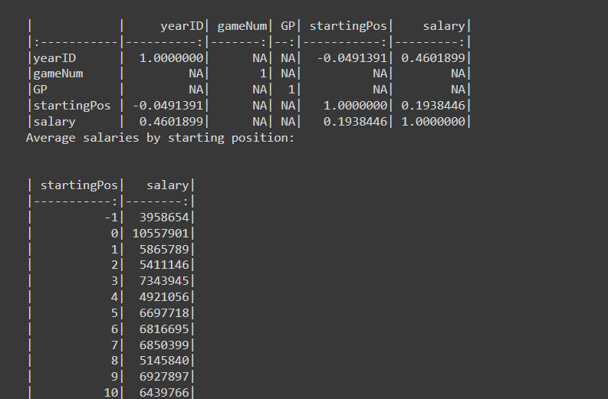
Extended Data Analysis

Slide 13
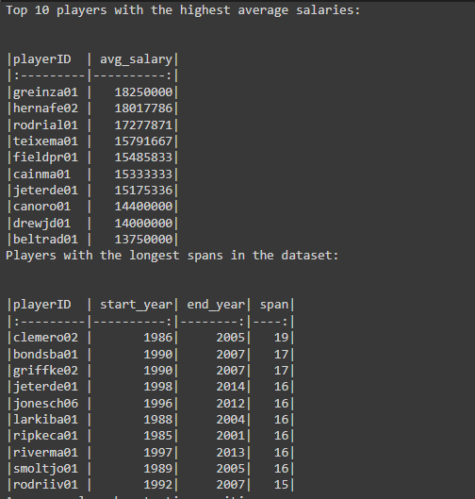
8. Further Data Analysis
Top earners were identified, and visualizations showcased relationships between performance and salary. Player longevity and position-based salary insights were also highlighted.

Slide 14
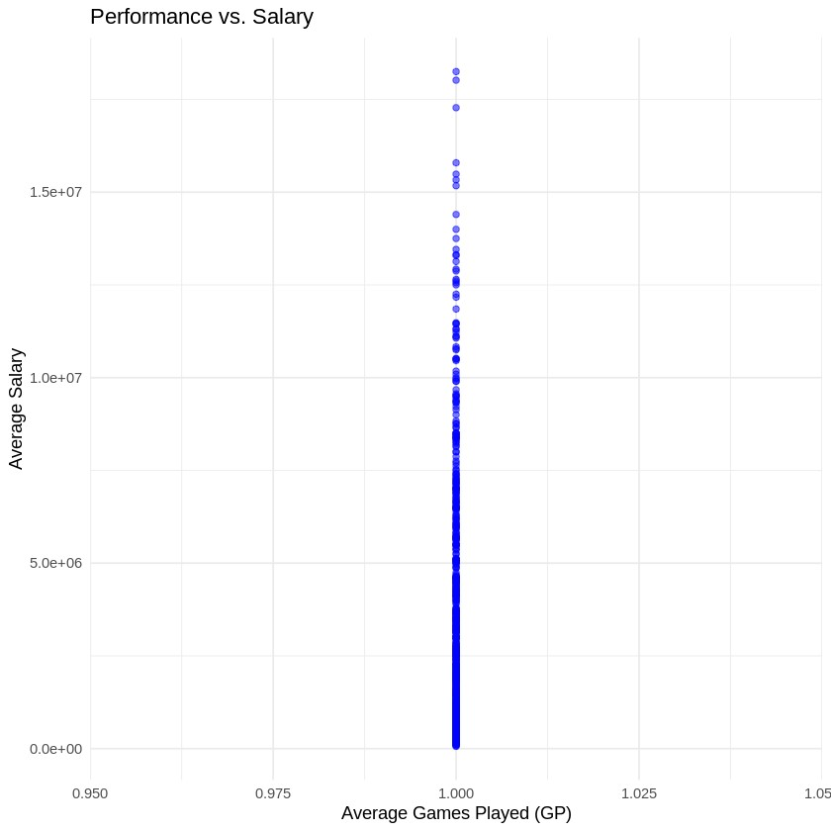
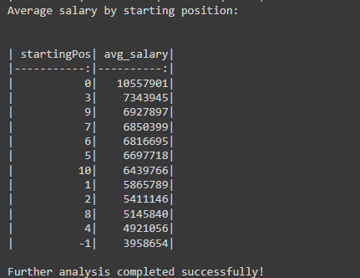
8.More Further Data Analysis

